Slide 1
Forged Banknote Clustering Analysis
By Michael Bennett

Slide 2
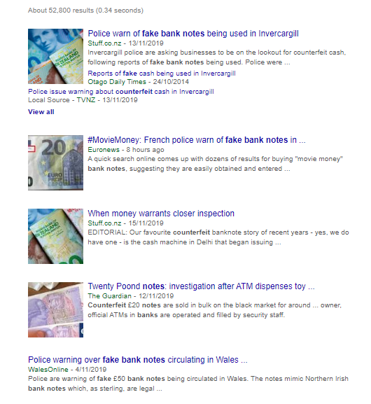
Introduction
Goal
The goal of this analysis is to cluster the “banknote.csv” dataset to distinguish genuine and forged banknotes. The dataset was extracted from images that were taken from genuine and forged banknotes.
Why?
Counterfeit notes can be a huge issue for companies, in some cases costing thousands them thousands of dollars. Visually it can be easy to detect, but one must actually take the time and effort to analyse each note, which can obviously be tedious in high-traffic businesses. A system that can detect forged banknotes would be highly beneficial.
Notes:
Goal is to predict whether a banknote is forged from a simple images features. (Variance, Skewness, Entropy, Kurtosis)

Slide 3
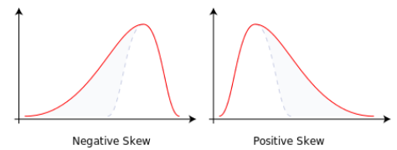
About the Data
The data => “banknote.csv”
For digitization, an industrial camera usually used for print inspection was used. The final images have 400x 400 pixels. Transform tool were used to extract features from images.
- V1 => Entropy
- Measure of “chaos” in the dataset, disorder
- V2 => Skewness
- Measure of asymmetry of the probability distribution
- V3 => Variance
- Spread of the data, expectation of the squared deviation of a random variable from the mean
- V4 => Kurtosis
- Measure of the “tailedness” of the probability distribution The kurtosis of any univariate normal distribution is 3. It is common to compare the kurtosis of a distribution to this value.
Notes:
Kurtosis => If less than 3, it is not seen as “flat topped” as people might think, rather it means the distribution produces fewer and less extreme outliers than does the normal distributionsample kurtosis is a useful measure of whether there is a problem with outliers in a data set. Larger kurtosis indicates a more serious outlier problem, and may lead the researcher to choose alternative statistical methods.

Slide 4
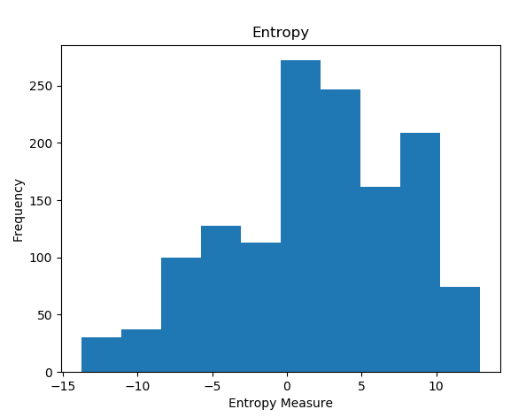
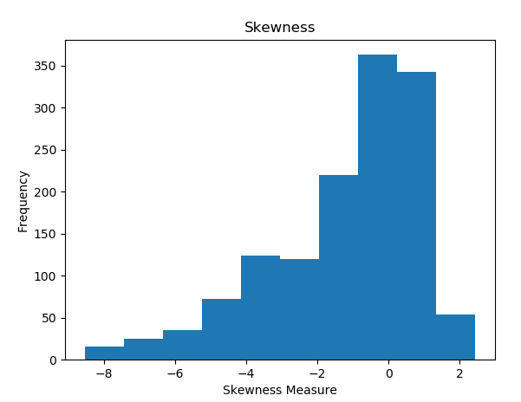
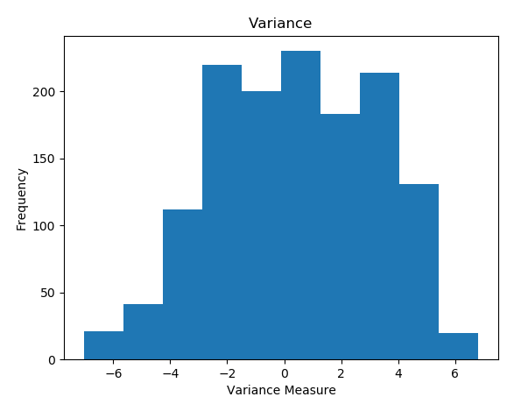
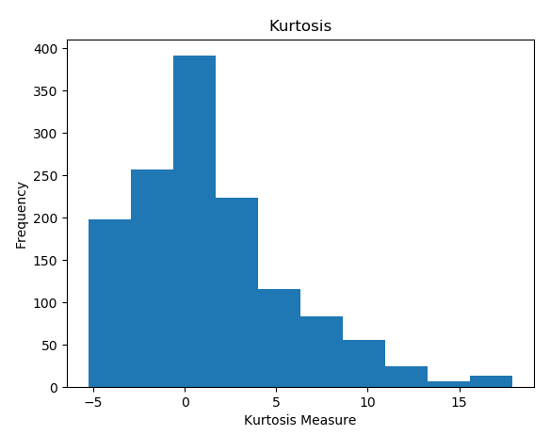
A look at the features
Notes:
Entropy: We can see that most the each banknote’s entropy tends to be around 0 and higher. So “randomness”/chaos of datapoints tends to higher more often than lower, meaning there is more uncertainty generally. A negative entropy essentially describes a more orderly system. A balance between order and disorder would be preferred as we want to detect abnormalities as well as more common occurrences to detect clusters of genuine and forged banknotes
Skewness: The skewness tends to lean to the right, indicating a skewness of bank notes leading to the Right
Variance: The variance of banknotes image data tends to be quite uniform, where a measure of -3 to 4 are quite common
Kurtosis: Kurtosis of banknotes tend to be negative.

Slide 5
Modelling Process
The Method I will use to test the accuracy of my unsupervised learning processing will be to submit to Kaggle, where the labels of the data is hidden. The goal is to predict the label for each column. The prediction will be either 1 or 0, where:
0 = Genuine Banknote
1 = Forged Banknote
- We will attempt to get the best result with the KMeans clustering model first

Slide 6
KMeans
How it works?
Basically initializes n centroids where n is the number of clusters you want to group the data into.
Measures distance of datapoints to centroids to group data together
Anything to watch out for?
- Initialization of centroids can be the downfall of Kmeans
- Positive is that we can choose the number of clusters intially
Preparations
Checked for missing data
Normalization/Standardization
Dimensionality Reduction
How to initialize centroids?

Slide 7
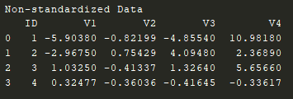
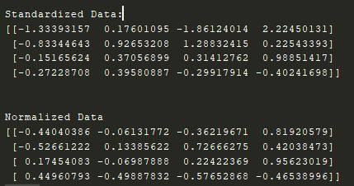
Pre-processing
Note that our beline accuracy (Kmeans without processing) is 40%. We must do better than this of course
There is thankfully no missing data values in the dataset
We are going to Standardize the data to prepare for Principle Component Analysis, a method to reduce dimensionality
We are also going to Normalize, I want to test the accuracies of using both these pre-processing techniques (independently of course)
Note we should remove the ID column!
Original Data
Standardization and Normalization
Notes:
Standardization: x’ = x – average(x) / std
Allows features to be compared that have different units/scales
Normalization: x’ = x – average(x) / max(x) – min(x)
Change of values of numeric columns in the dataset to a common scale without distorting distances in the range of values

Slide 8
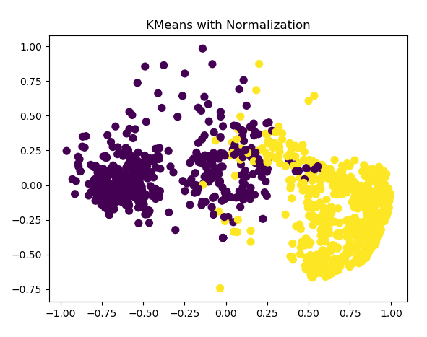
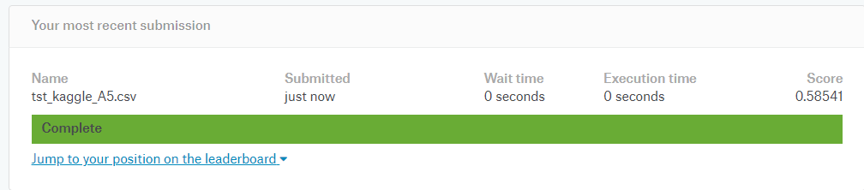
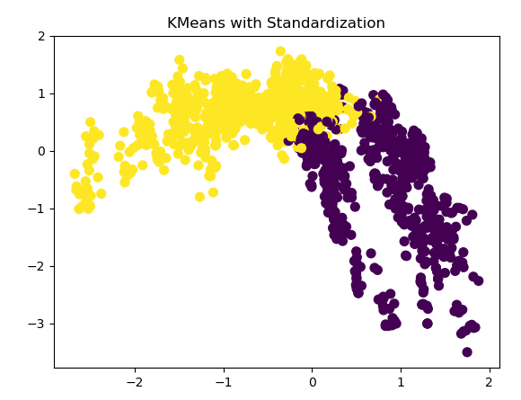
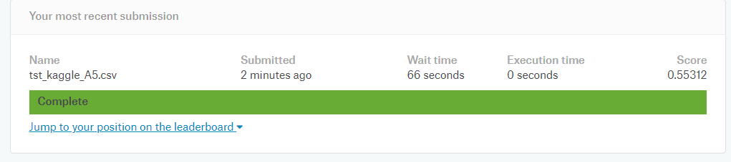
Results so far
Applying KMeans with Python and the method of normalization results in an accuracy of 58.54%
Applying KMeans with Python and the method of Standardization also results in a 55.3%
Notes:
Graphs show not too much separation k-means clustering is very sensitive to scale due to its reliance on Euclidean distance so be sure to normalize data if there are likely to be scaling problems.
Normalization seems to do better at separating the points.

Slide 9
Kmeans Improvements?
Principle Component Analysis Attempts to reduce the dimensionality of the dataset, or in other words, attempts to reduce the number of features so that we may obtain better or equal data with less variables.
We will also try to improve the way the initial centroids are chosen
Kmeans is known to suffer when there are outliers present, we should figure out a way to handle this.

Slide 10
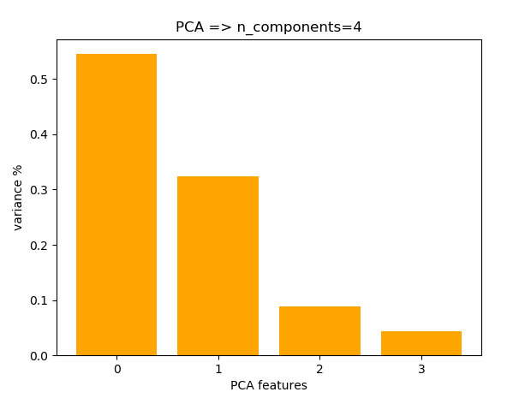
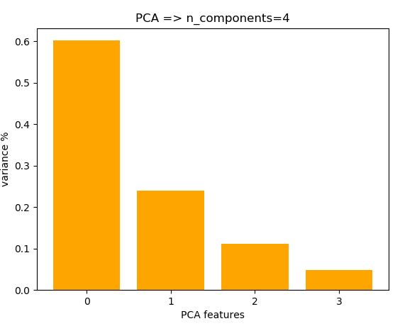
Principle Compnent Analysis (PCA)
PCA looks to extract the best combination of features possible from the dataset so that we maintain the datasets integrity, whilst reducing dimensionality.
Standardized
Normalized
Notes:
Curse of dimensionality, the more features the harder it generally is to find patterns. For clustering analysis this is key. The less features, the easier to distinguish datapoints
PCA uses orthoganol Transformation to convert a set of observations of possibly correlated variables into a set of variables that are linearly uncorrelated.
The idea is that if features display similar characteristics, then we can transform them to represent one general feature in a way. Thus we maintain the variance of the dataset. We would get the same patterns and insights as well as reduce the number of features (dimensionality)
Looking at the graph, we look at what PCA finds with n_components four, there is a variance drop off from P0 to P1 and P1 to P2. We could conclude that P0, P1 and P2 explain most of the variance in the data. We could essentially set n_components to 3 and pass the output to Kmeans and see if this helps.
Larger drop off between P0 and P1 for Normalized version, Larger drop off between P1 and P2 for standardized. (We could use 3 components for

Slide 11
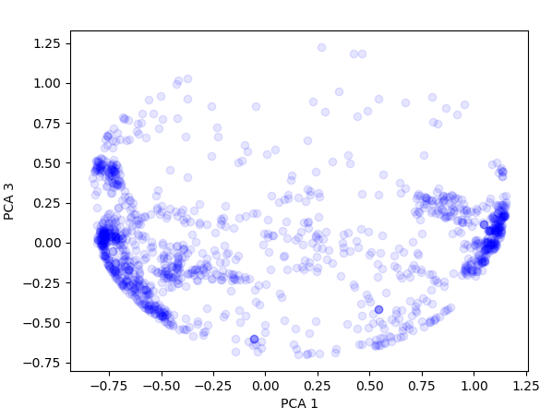
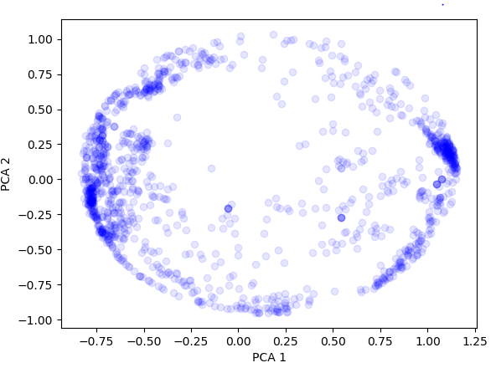
PCA continued…
PCA continued…
PCA, Normalized, n_components = 3
PCA, Normalized, n_components = 2
Notes:
There shape is very globular, so PCA is struggling to distinguish the data into two groups with 2 components
PCA 3 and PCA 1 together show that the data can possibly be distinguished, however there are still a great number of outliers. With PCA 2 and PCA 1 the data seems to not do as well at grouping separately. However in both , there are actual distinguishable clusters so lets move on to Kmeans!
We can see that

Slide 12
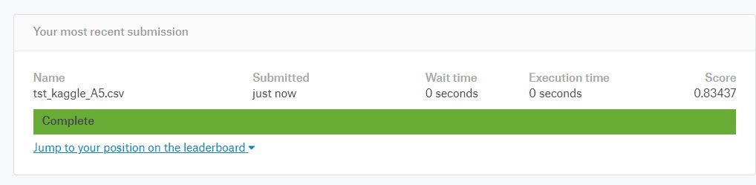
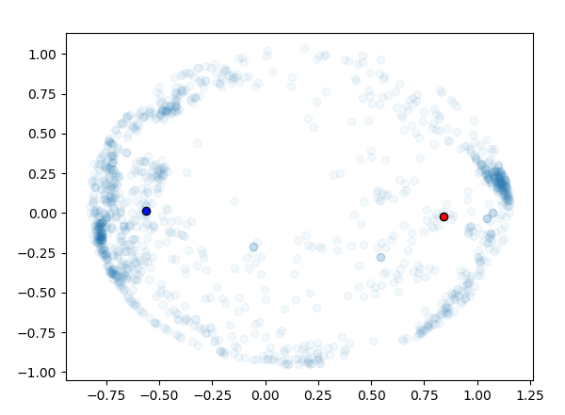
K-Means with PCA
Lets try K-Means with PCA, we want to see if there is a difference when selecting the 2 most principle components vs the 3 most principle components
n_components = 2
n_components = 2
n_components = 3
Notes:
We instantly get a massive increase in accuracy, 83%. The reduction of features has proved to work well. Noise is essentially processed out, and dimensionality reduced whilst keeping the integrity of the dataset. I also changed n_components to 3, and the result was the same. Cluster centers displayed on the right from the Kmeans clustering. Successfully seperates data quite well. We notice there are still a bit of outliers…. How to handle this??

Slide 13
Can we improve with only Kmeans?
We want to see if we can squeeze everything out of Kmeans
How are the initial centroids selected?
Default on python is “kmeans++”
This essentially picks initial cluster centers in a “smart way” to speed up convergence
What other options? What about “random”
Chooses k observations at random
No different results!!
We’ve got to handle the outliers it seems to improve our accuracy, this may call for a different method
Notes:
When running these, I received no different output!

Slide 14
Handling outliers
DBScan
Density Based Spatial Clustering of Applications with Noise.
Better at handling outliers
Sensitive to parameters (minsamples and eps)
Can be used for outlier/anomaly detection.
Agglomerative Clustering
Recursively merge the pair of clusters that minimally increases given linkage distance
Single link, complete link
Notes:
Min_samples = Minimum amount of points to be in a neighbourhood for a point to be considered a core point
eps = The maximum distance between two samples for one to be considered in the neighbourhood of another

Slide 15
DBScan
Classifies points as core point, border point or outlier
We will use DBScan to detect the outliers, we can then decide how to assign those outliers
Need to pick a good Eps, min_samples, distance function parameters
- Larger value of EPS, results in broader clusters
A larger value of min_samples results more robust clusters but may exclude potentially smaller areas as it attempts to merge them in a larger one, smaller min_samples may include noise as well…
We should attempt to make min_samples larger, as we want to make sure outliers are detected
Notes:
Core => A point is a core point has at least MinPoints within it’s eps neighbourhood
Border => A point has less than MinPts, but can be reached by a cluster, or is in the neighbourhood of a core point
Outlier => A point that cannot be reached by a cluster
Starts with random point that does not belong to cluster, keep doing this until a core point is reached. Add all directly reachable points to this cluster. Repeat until all points have been assigned to a cluster or is an outlier

Slide 16
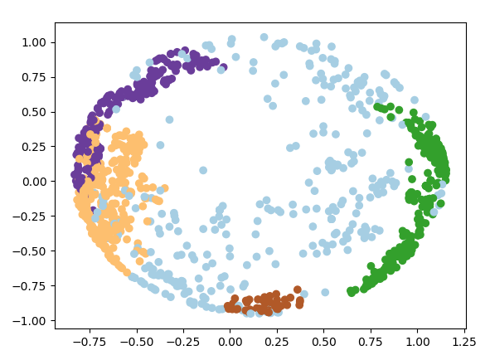
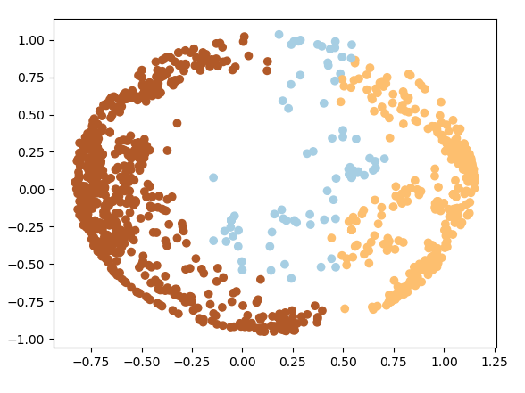
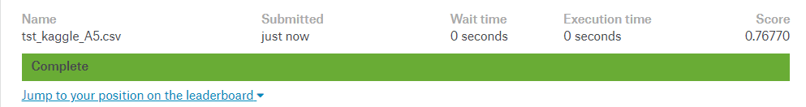
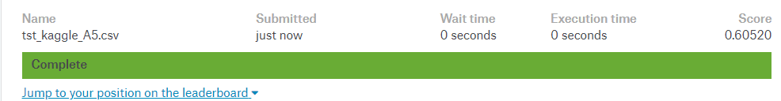
Assigning the outliers to a class
Our plan will be simple, lets assign the outliers to either forged/genuine banknotes cluster and test to see which performs better?
This will tell us whether those outliers are indeed forged or not!
Eps = 0.2 minPts = 31, n_components = 3 (PCA)
Eps = 0.2 minPts = 31, n_components = 2 (PCA)
Notes:
Now, Interestingly this is a weaker result than the Kmeans.
I tested many (realistic) values of EPS and minPoints
- You may notice that the Graph shows more than 2 clusters
What we do is assign all the “non-outliers” to the genuine class, and all the “outliers” to the forged class. Reducing it in a way to 2 clusters.
Acccuracies show the importance of the PCA step, the 3 components where needed to explain the datasets variance!

Slide 17
DBScan conclusion
One of the issues of DBScan is that it is heavily reliant on picking good Eps and minpoints values.
Time spent on discovering these values can be a lot!
There are other solutions we can look at another day:
OPTICS
Agglomerative Clustering
Notes:
DBScan picking values => Not a lot of resources out there! Specific to your dataset, you must use intuitive understanding!

Slide 18
Conclusion
In conclusion, the aim of this analysis was to build a model that could accurately classify whether a banknote was forged or genuine using Image data.
The best accuracy I could get (at my level of experience) was 83% correct predictions using a test set on Kaggle. This was done by:
Normalizing the data
Feature processing via Principal Component Analysis
Applying K-Means clustering method on Principle Components
We also had a look at the DBScan model which is more based on Density rather than distance. I achieved an accuracy of 77% with tuned parameters.
Overall I believe I can improve my model with a some parameter tuning, and possibly the addition of another model in conjunction with DBScan or Kmeans (ensemble).

